Slide 1
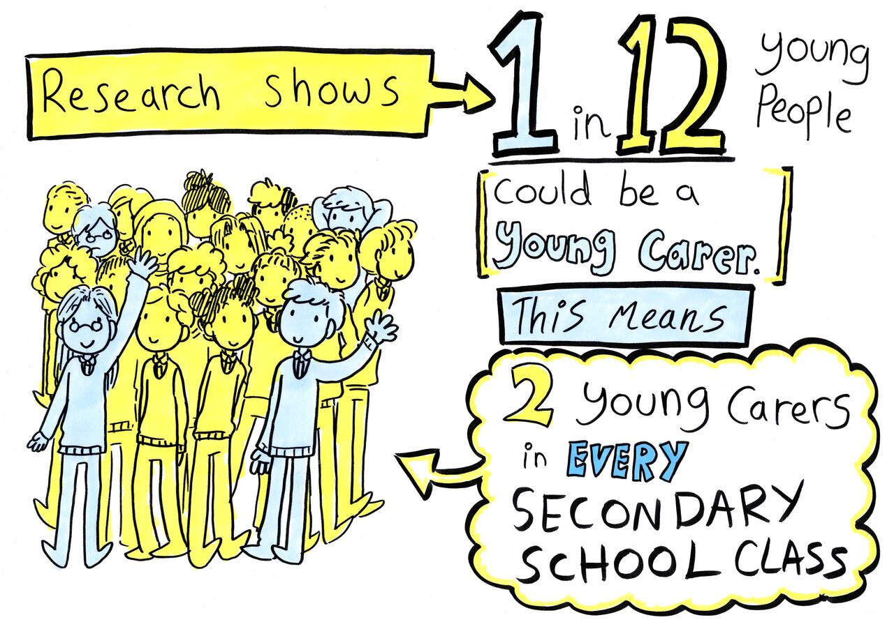
Gloucestershire Young Carers
Supporting the YOUNG in young carer

Slide 2
Who is a young carer?
A young person who helps to care for someone in their family affected by one or more of the following:
Physical
Disability
Learning
Disability
Mental
Illness
Physical
Illness
Substance Misuse

Slide 3
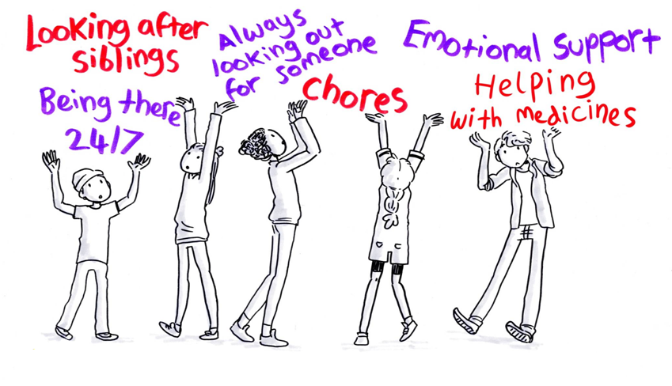
Young carers do all kinds of things to help the person they care for:
This might include:

Slide 4
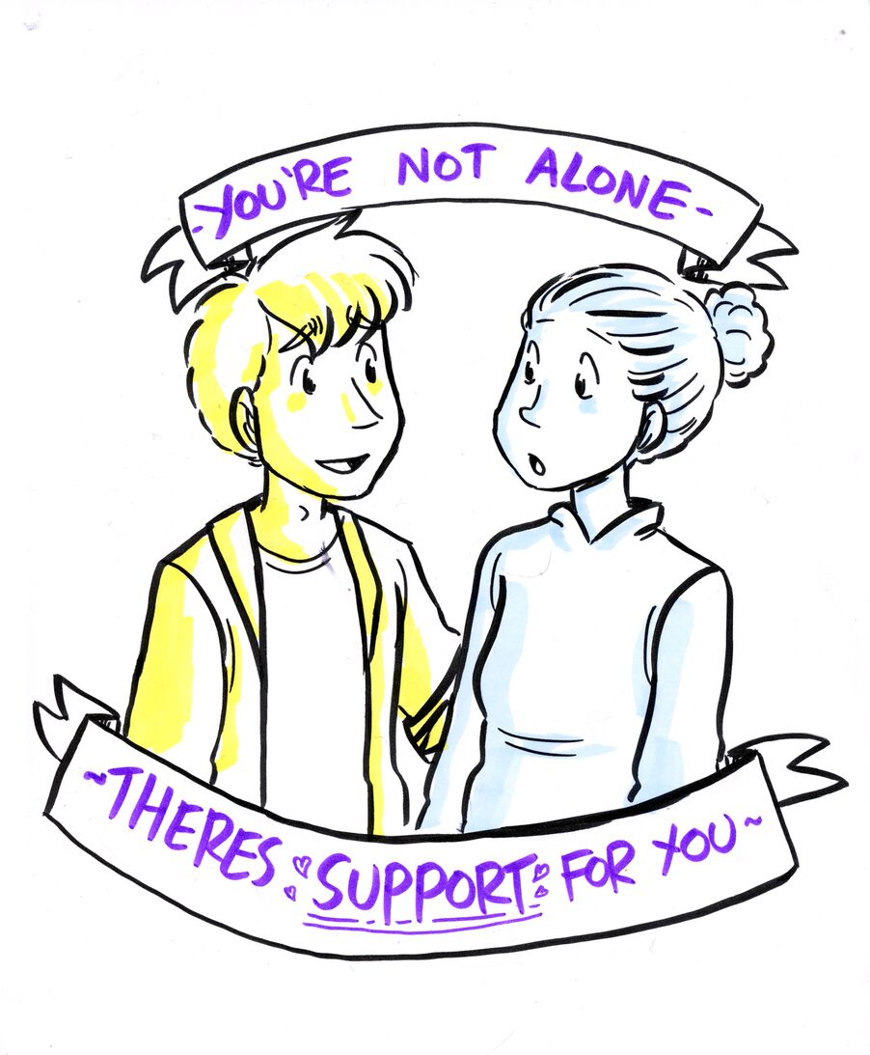
If you think you might be a young carer...
Talk to someone at school, call 01452 733060 or visit glosyoungcarers.org.uk

Slide 5
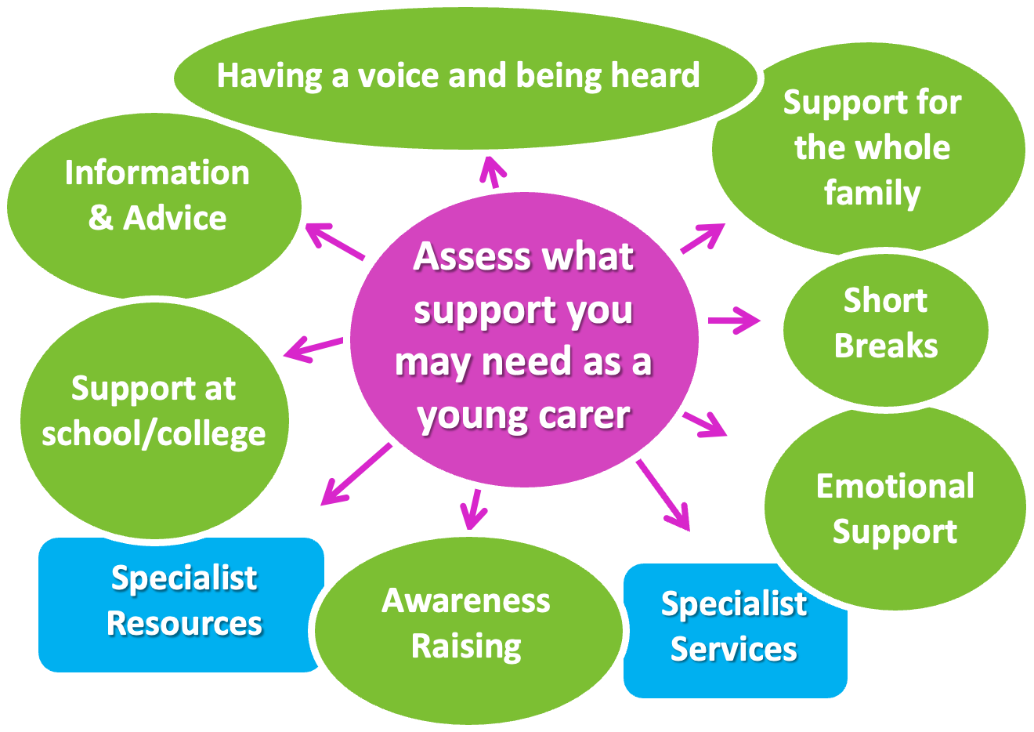
How do we support young carers?

