Slide 1
A-Level Business Studies Summer Task
Any queries, email Mrs Nicklin cni@ribstonhall.gloucs.sch.uk

Slide 2
A-Level Business Studies Summer Task 1
To help you start thinking about the Business Studies themes and topics, I would like you to conduct your own investigation into either a business role model or into a business of your choice, one that inspires or interests you. (It can be a small/ family business, it doesn’t have to be a global business).
This task should be presented as a PowerPoint presentation of no more than 6 main content slides. Imagine we have never heard of this entrepreneur or this business.
Please include information relating to the below:
• Who owns the business and how did they start it?
• What have they done in their career, give a brief history?
• What does the business do? How has it changed or grown over the years since it started?
• What is the business’ mission statement and what do you think of it/ why do you think they have chosen this?
• Who is the businesses’ target market?
• Who are the main competitors for the business? How well does your business compare to them/ compete with them? What evidence is there of this?
• How do the business differentiate themselves? Do they have a USP?

Slide 3
A-Level Business Studies Summer Task 2
Please create a glossary of key terms for Business Studies.
Entrepreneur
Marketing mix
Break even
Market research
Qualitative data
Quantitative data
Limited liability
Unlimited liability
Sole trader
Economies of scale
Extrapolation
Horizontal integration
Vertical integration
Globalisation
Glocalisation
Monopoly
Oligopoly
Monopolistic competition
Equilibrium
Social enterprise
Overdrafts
Share capital
Venture capital
Leasing
Trade credit
Debt factoring
Centralisation
Decentralisation
Economies of scale
Diseconomies of scale
Quantitative data
Qualitative data
Extrapolation
Working capital
Capital employed
Shareholder’s capital

Slide 4
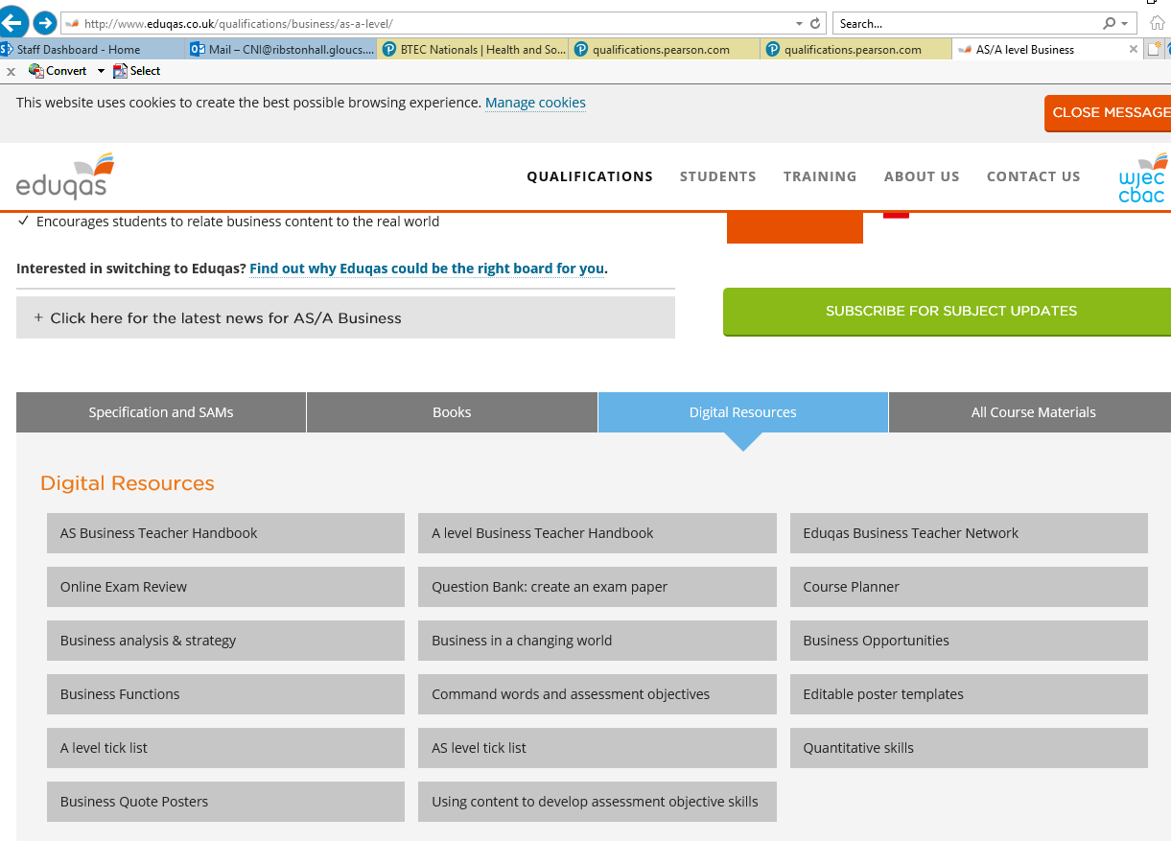
A-Level Business Studies Summer Task 3
Familiarise yourself with the WJEC EDUQAS website.
There is a section called ‘digital resources’. This is very useful information covering key course content.
http://www.eduqas.co.uk/qualifications/business/as-a-level/
The information on each component can be found under the following sections:
Component 1 – Business Opportunities
Component 1 – Business Functions
Component 2 – Business Analysis & Strategy
Component 3 – Business in a Changing World

